Slide 1
Database Schema Migration Strategy

Slide 2

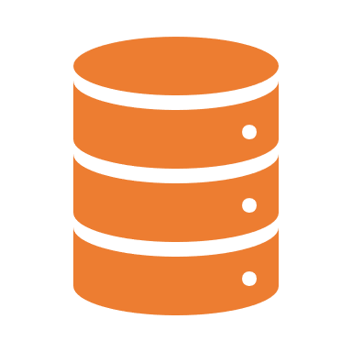
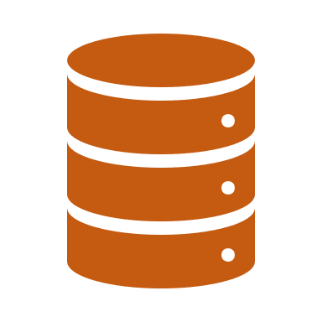
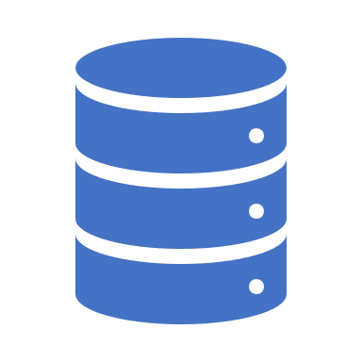


Challenges
Single Database so any changes to schema can impact all microservices. We are coupled both in terms of API Contracts as well as DB Schema.
Different environments exist (Dev, QA, Prod). We need to manage the database schema’s compatibility with all the microservice’s versions in all environments.
QA : Devcloud V2.0
Microservice A
Database
Microservice B
Prod : Devcloud V1.0.0
Dev : Devcloud V2.1

Slide 3
Strategy that can be used
For the first challenge we can communicate within the teams to determine possible effects of schema changes.
For the second challenge we can use database migration management tools like flyway.
Flyway let’s you determine what is the current version of the database.
Recreate the database from scratch to match any environment (prod, dev or QA).
Determine if any recent changes to database were deployed which affected the behavior.
Safely rollback in case of errors in migrations since it is transactional.

Slide 4
Flyway
Flyway can be thought as a version management/migration management tool for databases.
Flyway works by storing a separate table for migrations.
It also runs migrations as a separate transaction so the changes can be rollbacked by flyway itself on any error/exception.

Slide 5
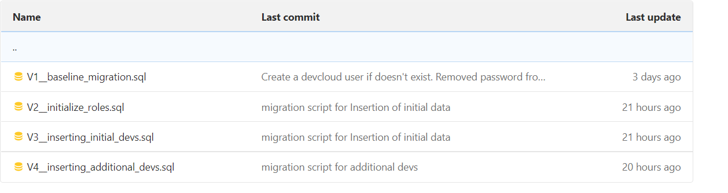
Flyway Cont..
On running the flyway script during deployment, it scans the folder for SQL scripts.
SQL scripts which have not previously been run are ordered and migrations are run in this order ( each SQL file has version number in its filename).
After successful migration, the version is then recorded in the database, so the same SQL won’t run on next migration.

Slide 6
Jenkins Pipeline
It makes sense to run flyway on deployment.
This can be achieved by making a separate pipeline for DB Migrations.
The pipeline will first setup a connection with the required environment’s database by making a local port forwarding.
It will clone the code and checkout the branch based on the environment we are deploying. And will start the script.
On completion (success or failure) the pipeline will display the message and delete the script files.
The pipeline can be run automatically on every deployment or on demand manually by DevOps.

Slide 7
Workflow for schema changes
On schema change, identify the microservices which can be impacted and make the required ORM changes.
Write the SQL script and test it locally by running the python script on local database to see if there are no errors. Refer readme.md to see installation steps.
On additions of new tables make sure the owner is changed to “devcloud”.
Make a merge request on the dev branch after testing.
For deploying schema changes, run the postgres-dev pipeline in Jenkins.
At the same time deploy all the microservices impacted by the schema changes so no API breaks due to schema incompatibility issues.

Slide 8



Demo
Gitlab Repo
Jenkins Build Server
Git Clone
Intel’s Network
Git Push
Local Port Forwarding
PostgreSQL Database Server
Local Port Forwarding (15432:5432)
AWS Network

Slide 9
Exceptions

Slide 10
Tasks Pending
Migrate the existing Dev and QA to be compatible with flyway by determining the changes in schema between QA and Dev.
Pipeline needs to handle exceptions in the script and display in the command line

Slide 11
Licensing
Flyway free version is open source but lacks features like undo migration, dry running the migration etc.

Slide 12
Existing database flyway migration : Changes in QA/Dev
For safety before making any changes do a proof check in a copy of the container.
Backup qa/dev data.
Run flyway clean to delete the schema.
Write DB Scripts to make DB Schemas to return back to qa/dev’s state. You also should have the baseline script in the repo.
Run flyway migrate. Now schema should exactly match the same as it did before integrating flyway. This won’t run the baseline script.
Simply copy over the data from the backup.

Slide 13
Questions

